Slide 1
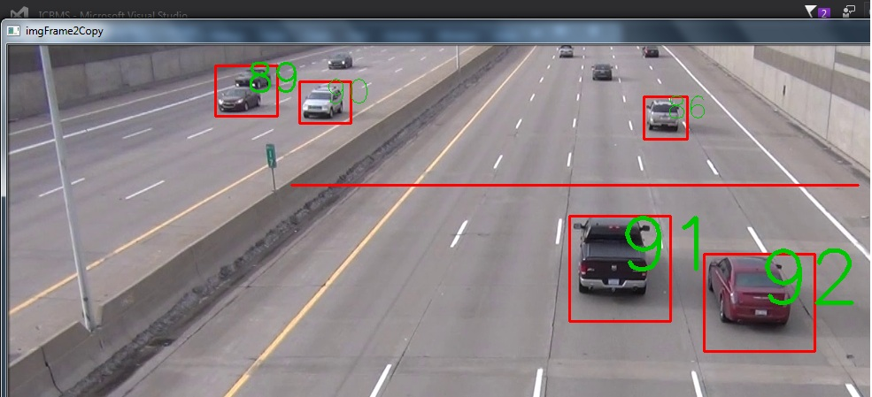
SELF DRIVING CARs PART II
This Photo by Unknown Author is licensed under CC BY-SA

Slide 2
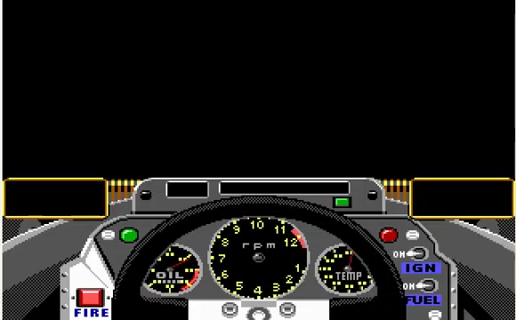
THE challenge
The challenge for this project was to create a Self Driving Car able to drive the GP Accolade simulator by:
Learn how to Capture Screen in order to read the controls in the cockpit
Use Lane Detection to adjusting Driving controls
Apply Vehicle Detection to avoid collisions
Notes:
In this video we can observe the controls in the cockpit such as speed, acceleration. Also we can estimate the position of the wheel with the red dot and also know when vehicles approaching by looking rear view mirrors.

Slide 3
DEMO: CONNECTING to dos box
Notes:
Using Lab1 Connection – demo how to connect DOS BOX to Python

Slide 4
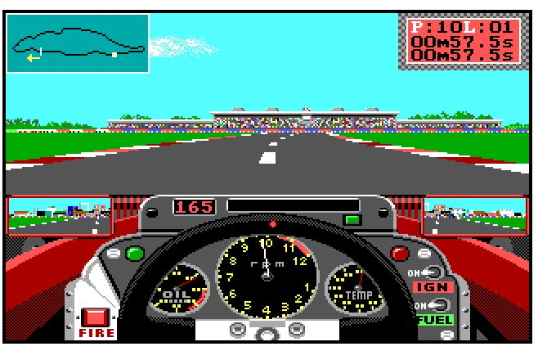
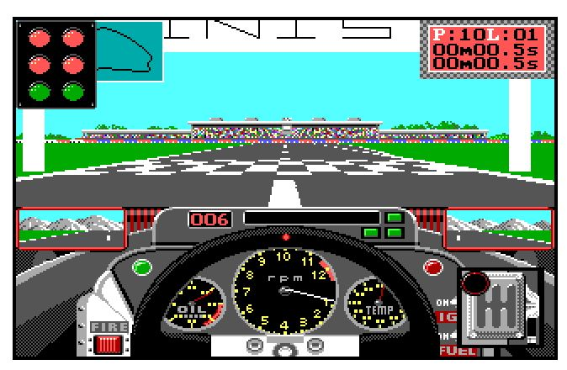
What can we capture?
2. Health meter
3. Pole Position, Lap Number,
Current Lap Time, Total Time
1. Traffic lights
7. Map
6. Speedometer
5. RPM gauge
4. Gears

Slide 5
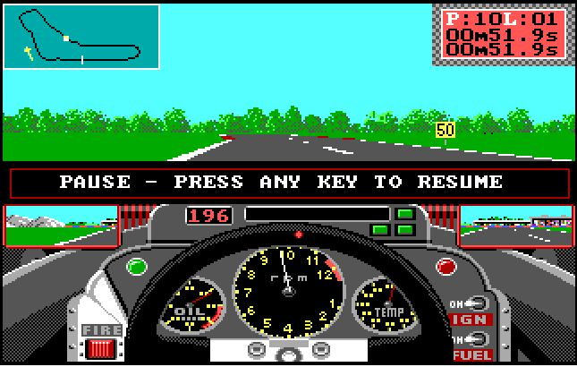
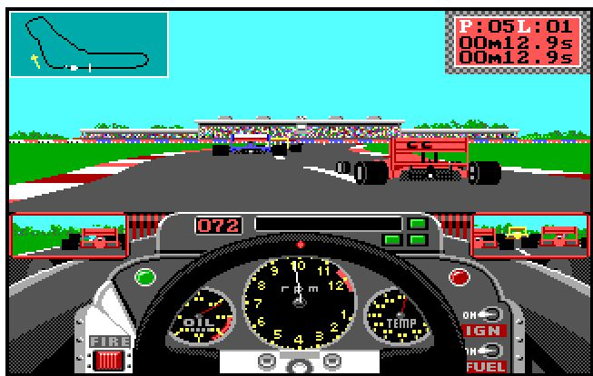
What can we capture?
9. Left Lane
9. Right Lane
10. Speed limit
9. middle Lane
11. Traffic detection
8.Steering angle
12. Rearview mirror

Slide 6
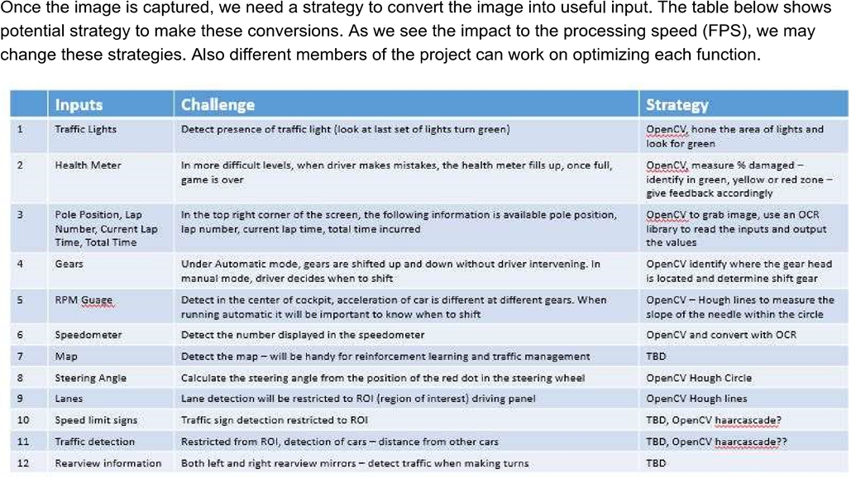
CAPTURING THE SCREEN

Slide 7
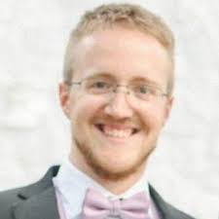
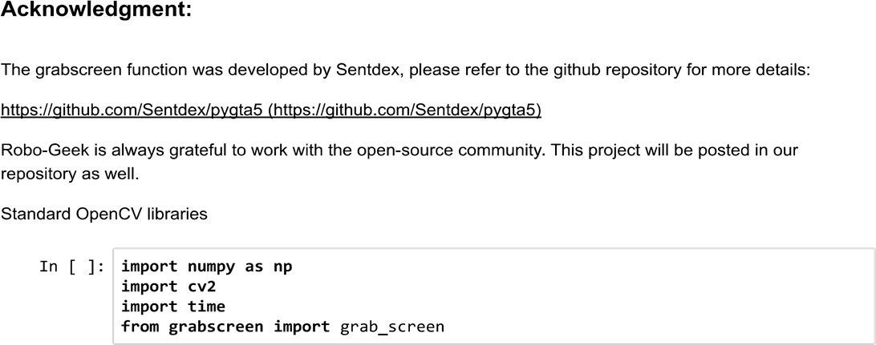

Slide 8
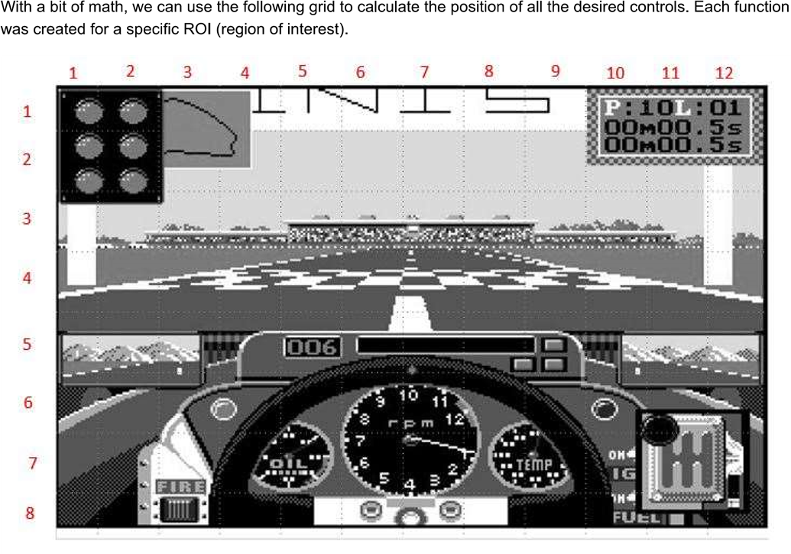
Capturing screen

Slide 9
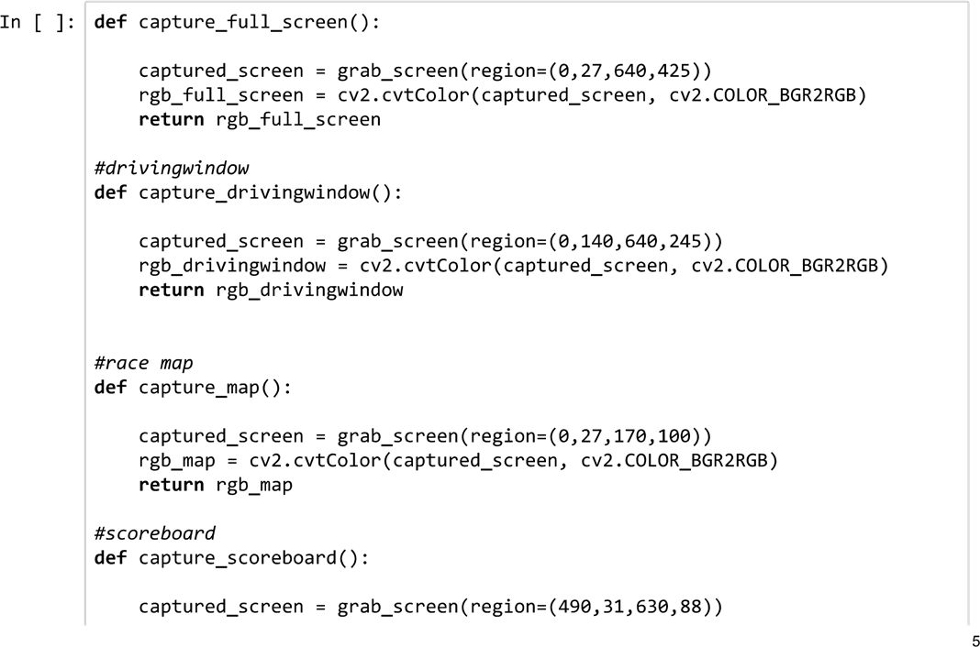
The CODE
This function reads the ROI (region of interest) and converts into RGB, the image is returned to be processed.
All other functions are similar but capture other regions.

Slide 10
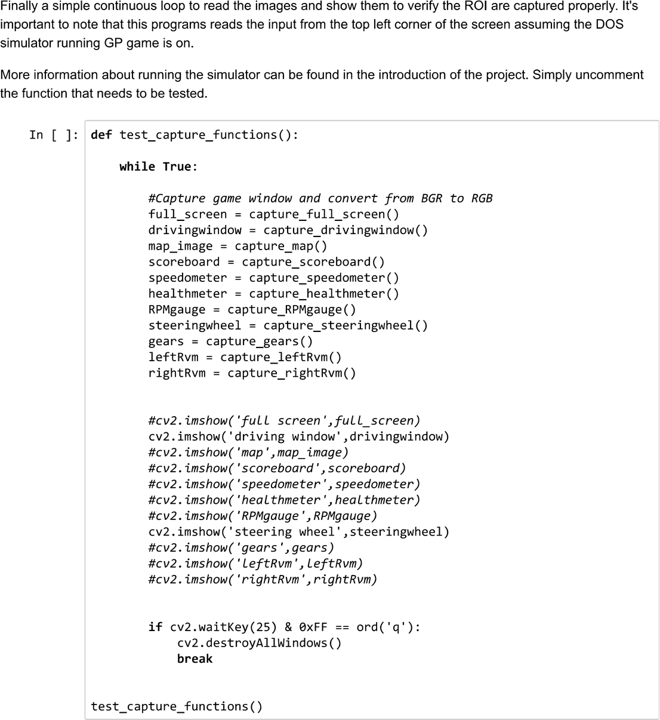
The CODE

